Slide 1

Functions
Python Basics
Cleveland PyLadies
Julie Novic
Jayce Renner
based on
Automate The Boring Stuff
Chapter 3

Slide 2
What is a function?
A function is a miniprogram within a program

Slide 3
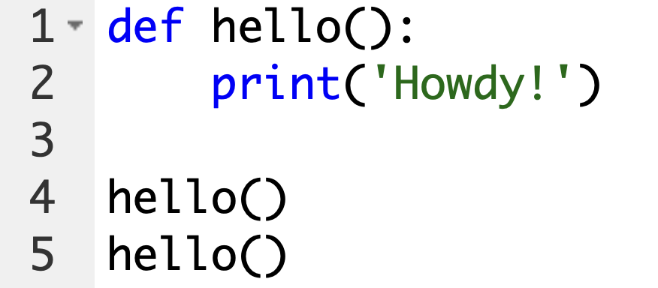
Let’s make a function!
First make a new file named this_has_functions.py
Then put this code in the file and run it -- what happens?

Slide 4
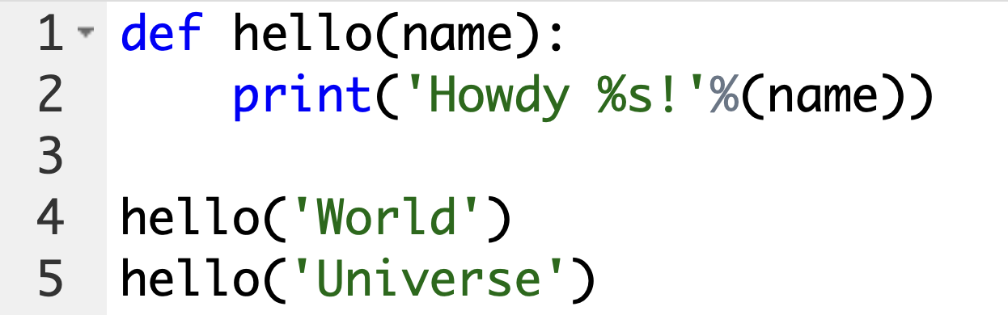
Let’s add a parameter
What do these terms mean?
Define, Call, Pass, Argument, Parameter

Slide 5
Functions as black boxes
Often, all you need to know about a function are its inputs (the parameters) and output value; you don’t always have to burden yourself with how the function’s code actually works. When you think about functions in this high-level way, it’s common to say that you’re treating a function as a “black box.”
You don’t need to know how functions work in order to use them.
For example, print()

Slide 6
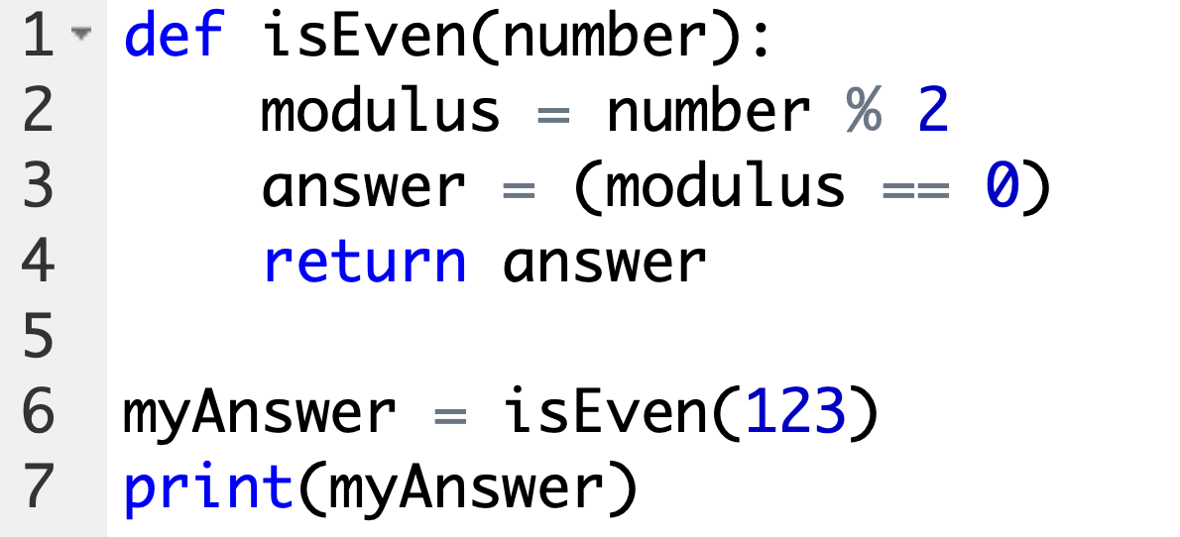
Return with functions
Add a new function with a return statement, then call the function

Slide 7
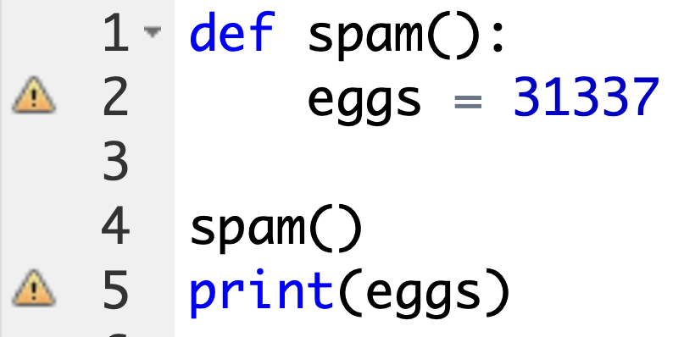
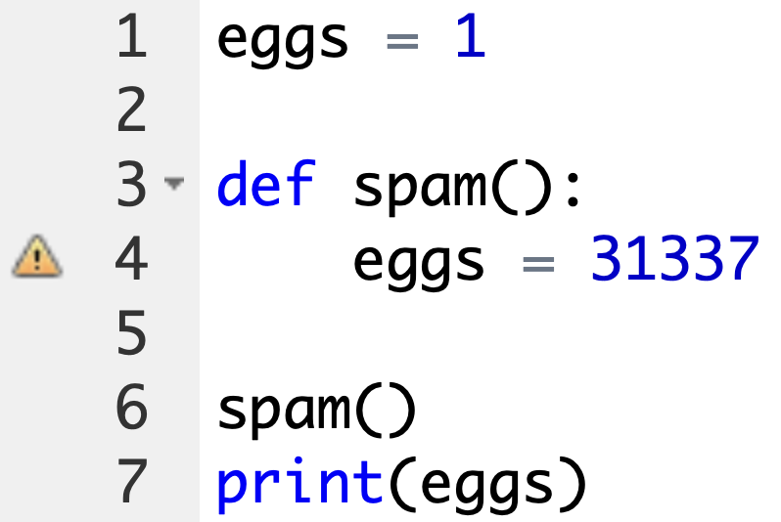
Scope -- Local vs Global
Let’s look at some code to understand scope
Example A
Example B

Slide 8
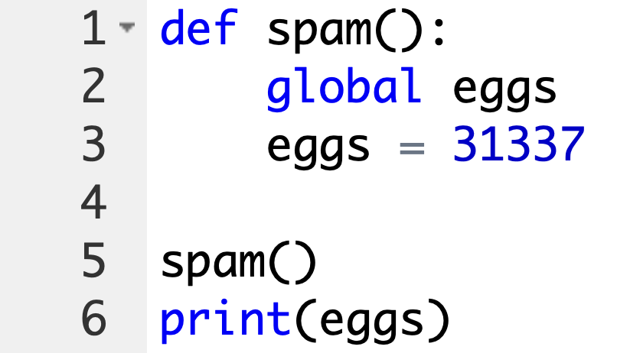
The global statement
You can use the global keyword to define a global variable inside a function -- then it becomes available anywhere
Example C

Slide 9
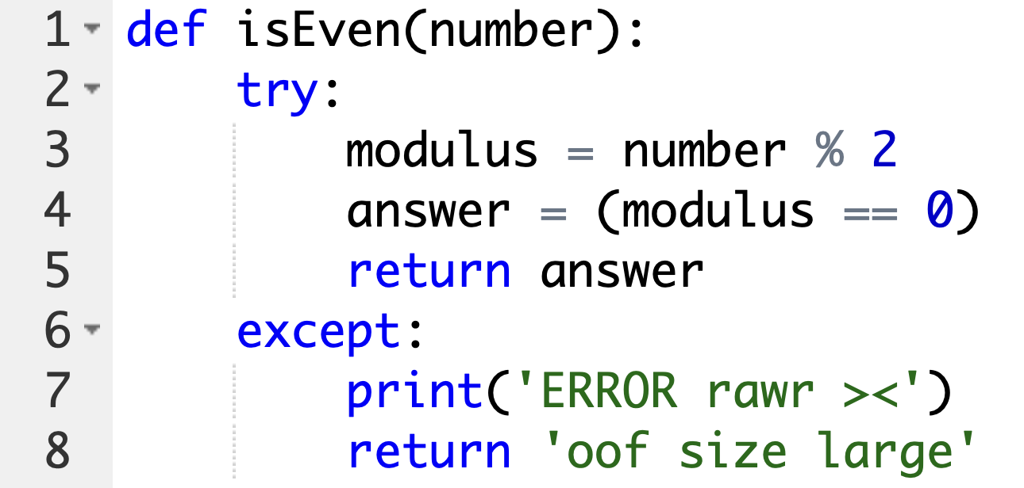
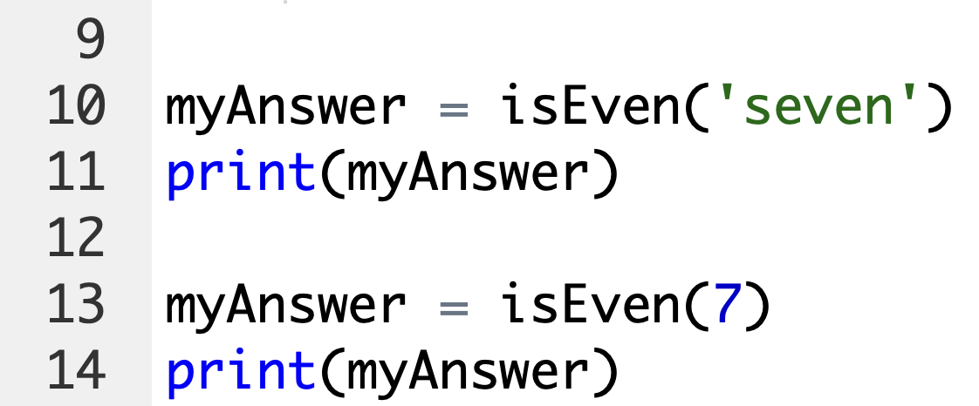
Error Handling with try…except
Error handling AKA exception handling lets your program
gracefully handle the unexpected and reduces bugs

Slide 10
Coding zigzag output
Let’s use the programming concepts you’ve learned so far to create a small animation program. This program will create a back-and-forth, zigzag pattern until the user stops it. When you run the program, the output will look something like this:
********
********
********
********
********
********
********
********
********

Slide 11
Summary
Functions are the primary way to compartmentalize your code into logical groups. Since the variables in functions exist in their own local scopes, the code in one function cannot directly affect the values of variables in other functions. This limits what code could be changing the values of your variables, which can be helpful when it comes to debugging your code.
Functions are a great tool to help you organize your code. You can think of them as black boxes: they have inputs in the form of parameters and outputs in the form of return values, and the code in them doesn’t affect variables in other functions.
In previous chapters, a single error could cause your programs to crash. In this chapter, you learned about try and except statements, which can run code when an error has been detected. This can make your programs more resilient to common error cases.

Slide 12
Homework for next time
Review chapter 4
Lists
https://automatetheboringstuff.com/2e/chapter4/

